Slide 1
Music Theory
Lessons
for the
Classroom
Created by Jamie Kraft
© Jamie Kraft 2015

Slide 2
Lesson 1: Music Vocabulary
Music
Staff
Pitch
Duration
Dynamics
Measures
Bar Lines
Meter Signatures
Treble Clef
Bass Clef
© Jamie Kraft 2015

Slide 3
Dynamics
Music
is sound.
Duration
Pitch
© Jamie Kraft 2015

Slide 4
Staff
The staff is a series of 5 lines and 4 spaces where notes are placed.
© Jamie Kraft 2015

Slide 5
Pitch
*Pitch is represented by the placement of notes on the staff.
© Jamie Kraft 2015

Slide 6
Duration
1 2 3 4
1 2 3
1 2
1
Duration is how long or short a tone is.
© Jamie Kraft 2015

Slide 7
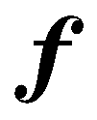
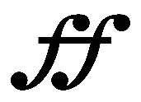
Dynamics
Forte loud
Mezzo forte medium loud
Fortissimo very loud
Piano soft
Mezzo piano medium soft
Pianissimo very soft
Dynamics are how loud and soft the music is.
© Jamie Kraft 2015

Slide 8
Measures
Measures are separated by bar lines and consist of a number of beats.
© Jamie Kraft 2015

Slide 9
Bar Lines
Bar lines separate each measure.
© Jamie Kraft 2015

Slide 10
Meter Signatures
Time Signatures
2 beats per measure
3 beats per measure
4 beats per measure
The quarter note gets the beat
The quarter note gets the beat
The quarter note gets the beat
Meter signatures determine how many beats per measure and the type of note that gets the beat.
© Jamie Kraft 2015

Slide 11
Treble Clef
The treble clef indicates the higher pitches on a staff.
© Jamie Kraft 2015

Slide 12
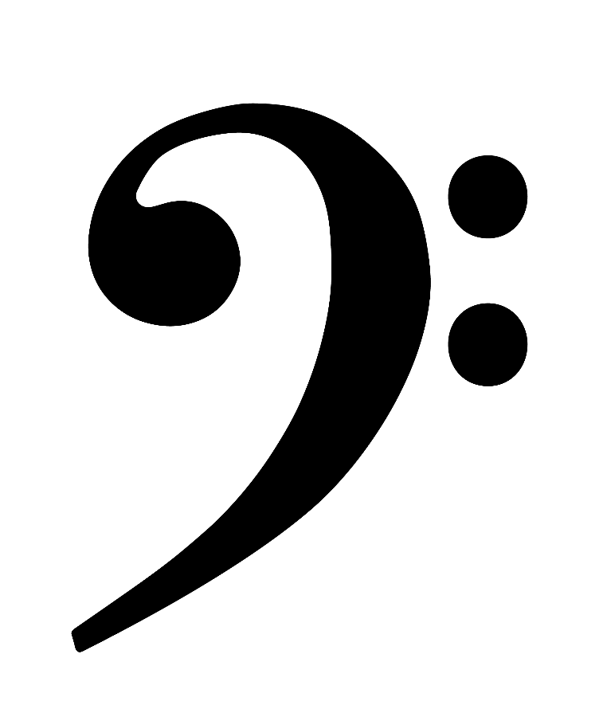
Bass Clef
The bass clef indicates the lower pitches on a staff.
© Jamie Kraft 2015

Slide 13
Lesson 1 Review
Music is ________.
How many lines make up a staff?
What is represented by the placement of notes on a staff?
__________ is how long or short a tone is.
Dynamics are how _______ and _______ the music is.
________ are separated by bar lines and consist of a number of beats.
7. _________ separate each measure.
Meter Signatures determine how many ______ per measure and what type of note gets the ______.
The _________ indicates the higher notes on a staff.
The Bass Clef indicates the ________ on a staff.
© Jamie Kraft 2015

Slide 14
Lesson 1 Review
1. Music is
Sound

Slide 15
Lesson 1 Review
2. How many lines make
up a staff?
5

Slide 16
Lesson 1 Review
3. What is represented
by the placement of
notes on a staff?
Pitch

Slide 17
Lesson 1 Review
4. _____ is how long
or short a tone is.
Duration

Slide 18
Lesson 1 Review
5. Dynamics are how ___
and ____ the music is.
Loud, soft

Slide 19
Lesson 1 Review
6. ____ are separated by
bar lines and consist of
a number of beats.
Measures

Slide 20
Lesson 1 Review
7. _____ separate each
measure.
Bar Lines

Slide 21
Lesson 1 Review
8. Meter Signatures determine
how many____ per measure
and what type of note gets the
____.
Beats, Beat

Slide 22
Lesson 1 Review
9. The ____ indicates the
higher notes on the staff.
Treble Clef

Slide 23
Lesson 1 Review
10. The _____ indicates the
lower notes on the staff.
Bass Clef

Slide 24
Lesson 2: Note Names
A B C D E F G
© Jamie Kraft 2015

Slide 25
F
E
D
C
B
A
G
F
E
Each line and space on the treble clef has a letter name.
© Jamie Kraft 2015

Slide 26
E
C
A
F
A way to remember the note names on the treble clef spaces is to use the rhyming words: SPACE-FACE
© Jamie Kraft 2015

Slide 27
F
D
B
G
E
A way to remember the note names on the treble clef lines is by using the saying: Every Good Boy Does Fine
© Jamie Kraft 2015

Slide 28
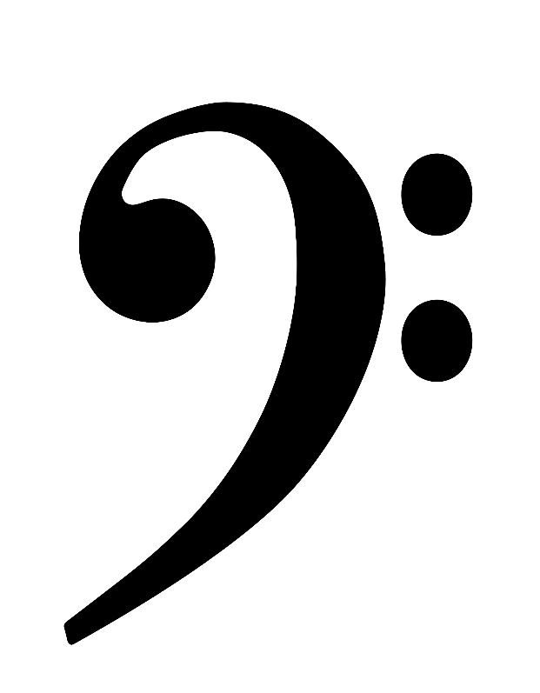
A
G
F
E
D
C
B
A
G
Each line and space on the bass clef has a letter name.
© Jamie Kraft 2015

Slide 29
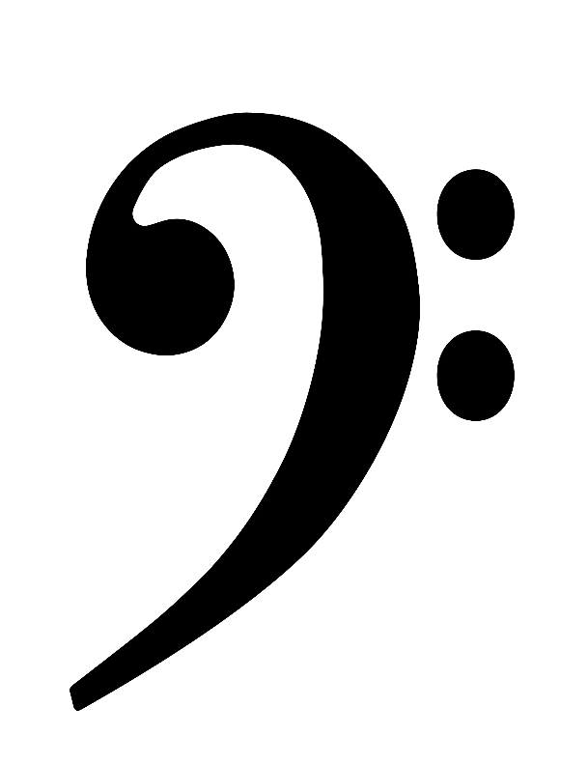
G
E
C
A
A way to remember the note names on the bass clef spaces is to use the saying: All Cows Eat Grass
© Jamie Kraft 2015

Slide 30
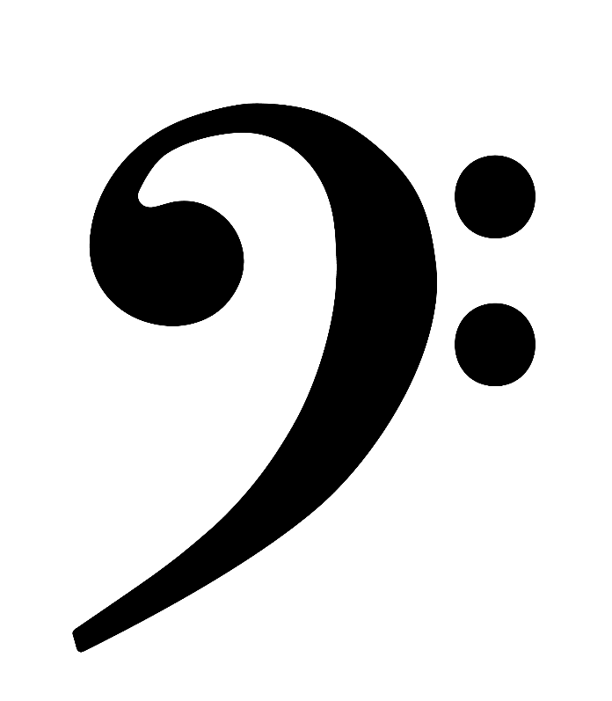
A
F
D
B
G
A way to remember the note names on the bass clef lines is by using the saying: Good Boys Do Fine Always
© Jamie Kraft 2015

Slide 31
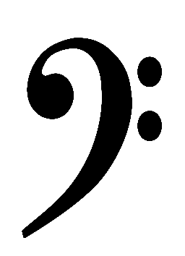
Together, the treble clef and bass clef create the
Grand Staff
© Jamie Kraft 2015

Slide 32
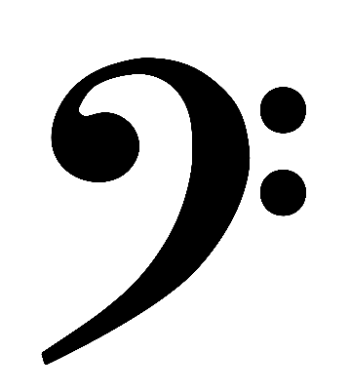
Pitches extending outside of the staff use ledger lines.
© Jamie Kraft 2015

Slide 33
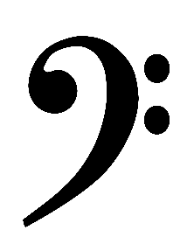
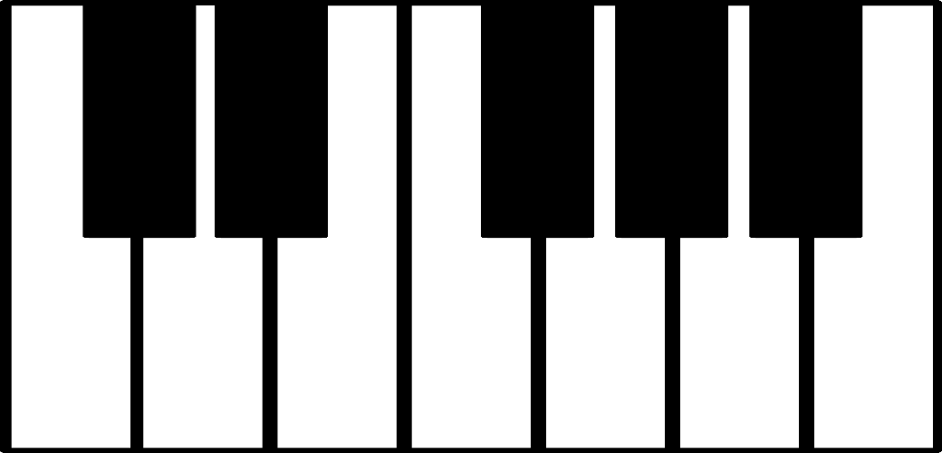
Keys on the piano keyboard represent pitches.
© Jamie Kraft 2015

Slide 34
Lesson 2 Review
A way to remember the note names in the treble clef spaces is to use which rhyming words?
A way to remember the note names on the treble clef lines is to use which saying?
A way to remember the note names in the bass clef spaces is to use which saying?
A way to remember the note names on the bass clef lines is to use which saying?
________ are used with pitches that extend beyond the staff.
The __________ is the treble clef and bass clef combined.
__________ represent pitches on the piano keyboard?
Critical Thinking: Name the 7 letters in the musical alphabet.
© Jamie Kraft 2015

Slide 35
Lesson 2 Review
A way to remember
the note names in the
treble clef spaces is to use
which rhyming words?
Space-Face

Slide 36
Lesson 2 Review
2. A way to remember the
note names on the treble clef
lines is to use which saying?
Every Good Boy Does Fine

Slide 37
Lesson 2 Review
3. A way to remember the
note names in the bass clef
spaces is to use which saying?
All Cows Eat Grass

Slide 38
Lesson 2 Review
4. A way to remember the
note names on the bass clef
lines is to use which saying?
Good Boys Do Fine Always

Slide 39
Lesson 2 Review
5. ________ are used with
pitches that extend beyond
the staff.
Ledger Lines

Slide 40
Lesson 2 Review
6. The __________ is the
treble clef and bass clef
combined.
Grand Staff

Slide 41
Lesson 2 Review
7. __________ represent
pitches on the
piano keyboard?
Keys

Slide 42
Lesson 2 Review
8. Critical Thinking:
Name the 7 letters in the
musical alphabet.
A B C D E F G

Slide 43
Lesson 2 Exercise
Directions: Write in the missing note names in the blank boxes. Use the musical alphabet A B C D E F G.
C
E
F
A
B
D
E
G
A
© Jamie Kraft 2015

Slide 44
Lesson 2 Exercise Answers
Directions: Write in the missing note names in the blank boxes. Use the musical alphabet A B C D E F G.
C
D
E
F
G
A
B
C
D
E
F
G
A
B
© Jamie Kraft 2015

Slide 45
Lesson 3: Types Of Notes
© Jamie Kraft 2015

Slide 46
Quarter Note
A quarter note gets one beat.
© Jamie Kraft 2015

Slide 47
Quarter Note
When using the meter signature there are 2 beats in each measure. This means that there can be 2 quarter notes per measure.
© Jamie Kraft 2015

Slide 48
Half Note
A half note gets two beats.
© Jamie Kraft 2015

Slide 49
Half Note
When using the meter signature there are 2 beats in each measure. This means that there can be 1 half note per measure.
© Jamie Kraft 2015

Slide 50
Dotted Half Note
A dotted half note gets three beats.
© Jamie Kraft 2015

Slide 51
Dotted Half Note
When using the meter signature there are 3 beats in each measure. This means that there can be 1 dotted half note per measure.
© Jamie Kraft 2015

Slide 52
Whole Note
A whole note gets four beats.
© Jamie Kraft 2015

Slide 53
Whole Note
When using the meter signature there are 4 beats in each measure. This means that there can be 1 whole note per measure.
© Jamie Kraft 2015

Slide 54
Lesson 3 Review
How many beats does a quarter note get?
How many beats does a half note get?
How many beats does a dotted half note get?
How many beats does a whole note get?
If there are 2 beats per measure, how many quarter notes can there be per measure?
If there are 2 beats per measure, how many half notes can there be per measure?
If there are 3 beats per measure, how many dotted half notes can there be per measure?
If there are 4 beats per measure, how many whole notes can there be per measure?
© Jamie Kraft 2015

Slide 55
Lesson 3 Review
How many beats
does a quarter note get?
1

Slide 56
Lesson 3 Review
2. How many beats
does a half note get?
2

Slide 57
Lesson 3 Review
3. How many beats
does a dotted half note get?
3

Slide 58
Lesson 3 Review
4. How many beats
does a whole note get?
4

Slide 59
Lesson 3 Review
5. If there are 2 beats per
measure, how many quarter
notes can there be
per measure?
2

Slide 60
Lesson 3 Review
6. If there are 2 beats per
measure, how many half
notes can there be
per measure?
1

Slide 61
Lesson 3 Review
7. If there are 3 beats
per measure, how many
dotted half notes can there
be per measure?
1

Slide 62
Lesson 3 Review
8. If there are 4 beats
per measure, how many
whole notes can there
be per measure?
1

Slide 63
Lesson 3 Exercise
Directions: Draw a line from the meter signature to the correct beats on the staff.
© Jamie Kraft 2015

Slide 64
Lesson 3 Exercise Answers
Directions: Draw a line from the meter signature to the correct beats on the staff.
© Jamie Kraft 2015

Slide 65
Overview Of Rests
For each type of note, there is a complementary rest. A rest indicates silence for a certain number of beats
Quarter Rest 1 beat
Half Rest 2 beats
Dotted Half Rest 3 beats
Whole Rest 4 beats
© Jamie Kraft 2015

Slide 66
Music Theory
Lessons
for the
Classroom
Created by Jamie Kraft
© Jamie Kraft 2015

Slide 67
Terms Of Use
If you would like to share this product with other educators, please purchase additional licenses.
Thank you so much for your purchases. You are very appreciated! Leave feedback and ratings after your purchase and earn TpT credits!
Click HERE for more of my products.
Follow me on PINTEREST
Subscribe to my BLOG
Images and Graphics credited to Scrappin Doodles
© Copyright 2015 Jamie Kraft. All rights reserved. Permission is granted to copy pages specifically designed for student or teacher use by the original purchaser or licensee. The reproduction of any other part of this product is strictly prohibited. Copying any part of this product and placing it on the Internet in any form (even a personal/classroom website) is strictly forbidden. Doing so makes it possible for an internet search to make the document available on the internet, free of charge, and is a violation of the Digital Millennium Copyright Act (DMCA).

Slide 68
Music Theory Bundle Includes:
Lesson One Lesson Three
Music Quarter note
Staff Half note
Pitch Dotted half note
Duration Whole note
Dynamics Quarter notes and meter signatures
Measures Half notes and meter signatures
Bar Lines Dotted half notes and meter signatures
Meter Signatures Whole notes and meter signatures
Treble Clef Lesson 3 Review
Bass Clef Lesson 3 Exercise
Lesson 1 Review
Overview of Rests
Lesson Two
Note names on the treble clef
Note names on the treble clef spaces Note names on the treble clef lines
Note names on the bass clef spaces
Note names on the bass clef lines
The grand staff
Ledger lines
Pitches on the piano keyboard
Lesson 2 Review
Lesson 2 Exercise
© Jamie Kraft 2015

