Slide 1
Soundscapes & Using a DAW to mix the sounds
(Digital Audio Workstation)

Slide 2
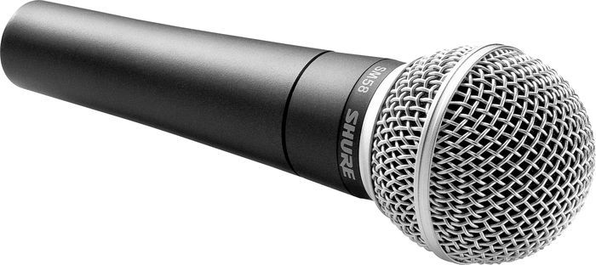
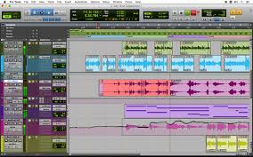
In this assignment you will be learning how to
Record sounds on your phone
Use BAND LAB (online DAW – Digital Audio Workstation)
Use Upload to create your own remix of music
Use LOOPS as used in EDM (Electronic Dance Music) music
Use DRUM SAMPLES to make your music more interesting
Use STRUCTURE, TEMPO and DYNAMICS to make your music more interesting
Extension:
Use MIDI (Musical Instrument Digital Interface) keyboards to create your own samples and ideas
Use more complex software FX (effects) to give your music real style and charisma in your chosen style (Dub, Lounge, Garage, Classical, Hip hop – the choice is yours).
Use Automation (volume and panning) to subtly change the volume and way in which music comes through the speakers or headphones, as in professional recordings.

Slide 3
To get onto (sign up) the DAW – Band Lab (education)
Step one – Use the link provided by the teacher in Teams or go to: https://edu.bandlab.com/ and use the Student LogIn tab – use the code provided by the teacher
***MAKE sure you use this website NOT the adult version (BandLab)
*** Do NOT use a profile picture, or the chat
Step 2 – Make an account using your school email address and password

Slide 4
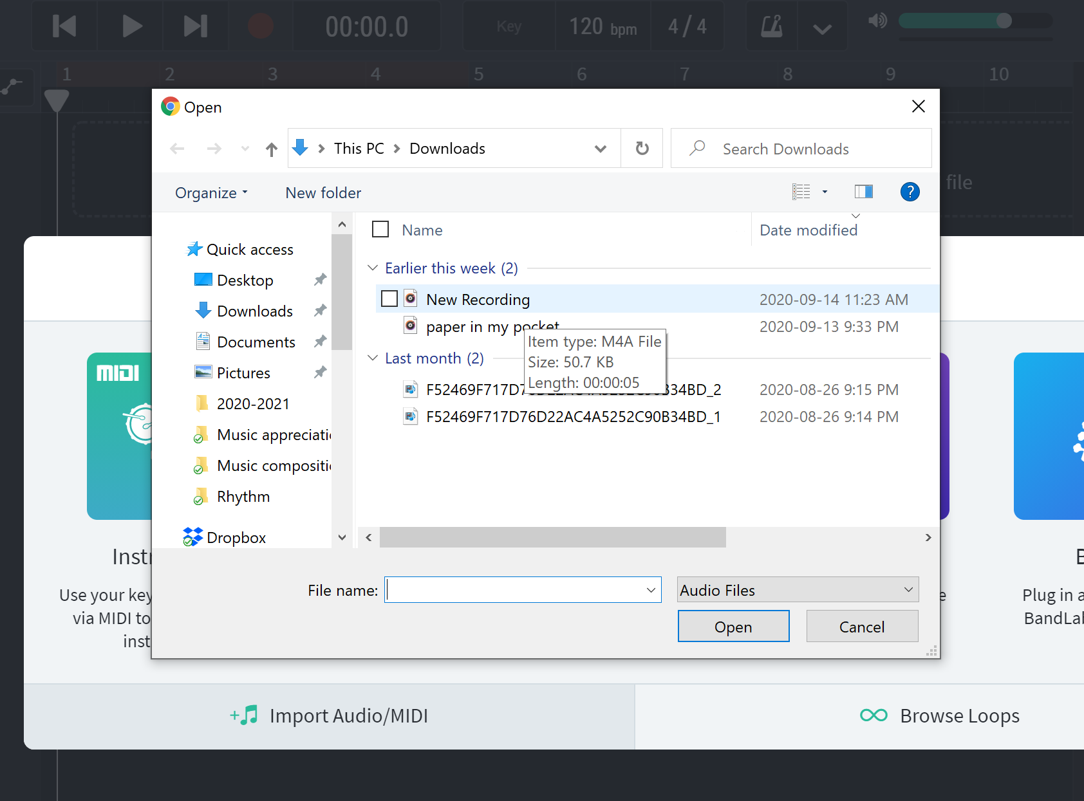
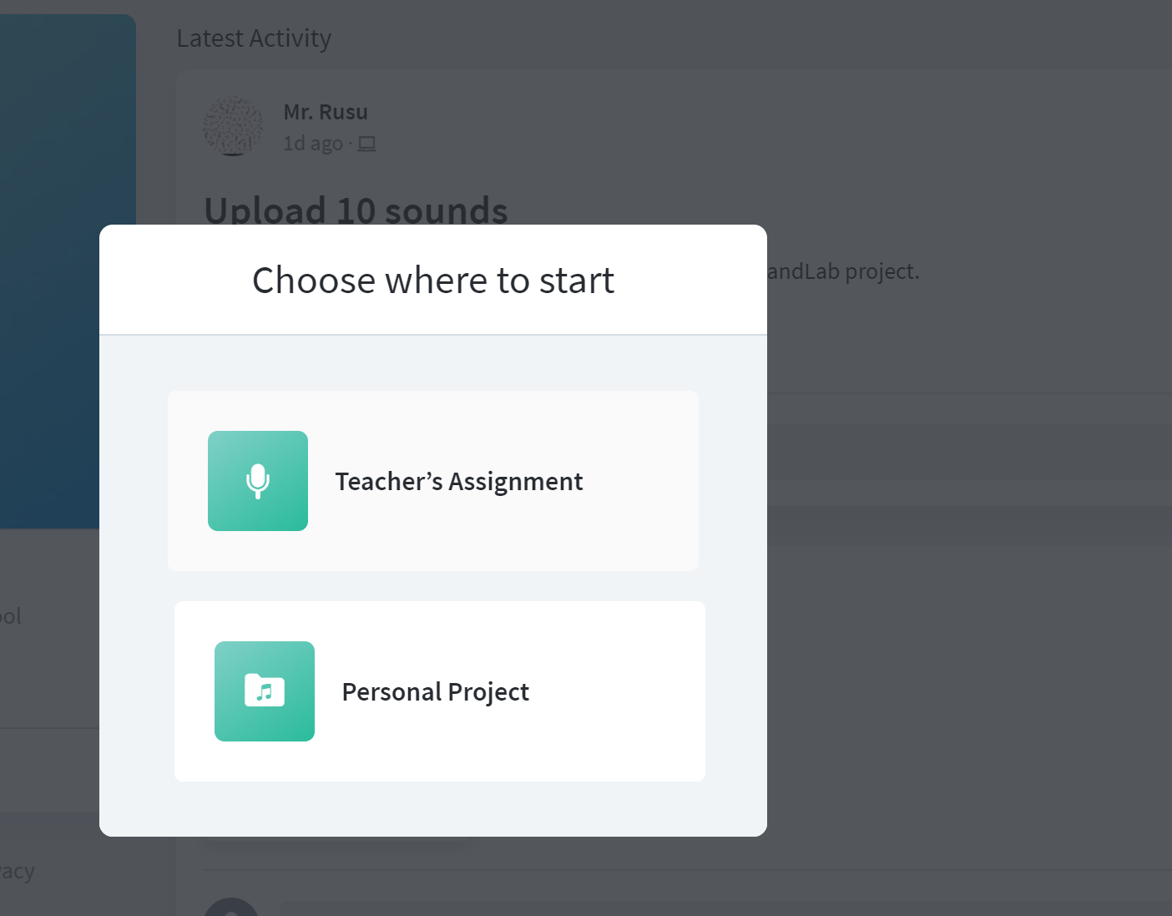
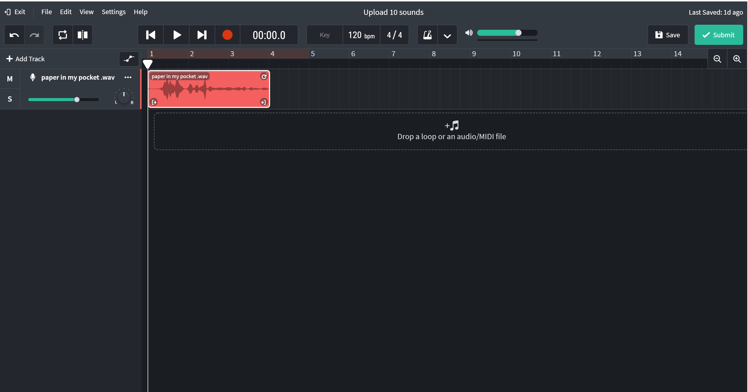
Skill 1 – Upload audio files from your phone
- click on your class name
- choose the assignment given by the teacher
- Click – Start Assignment
- Choose – Teacher’s Assignment
- Click - Import Audio/MIDI
- Choose your audio file to upload
OR…
(Drag the file to where it says:
Drop a loop or an audio/MIDI file)

Slide 5
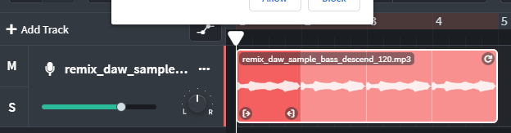
Skill 2: LOOP your SAMPLE
Hover the mouse over the top – right part of the sample a double arrow will come up
Hold the left button of mouse to drag it along!
TIP: Try and make 4/8 bar phrasing to make it regular!

Slide 6
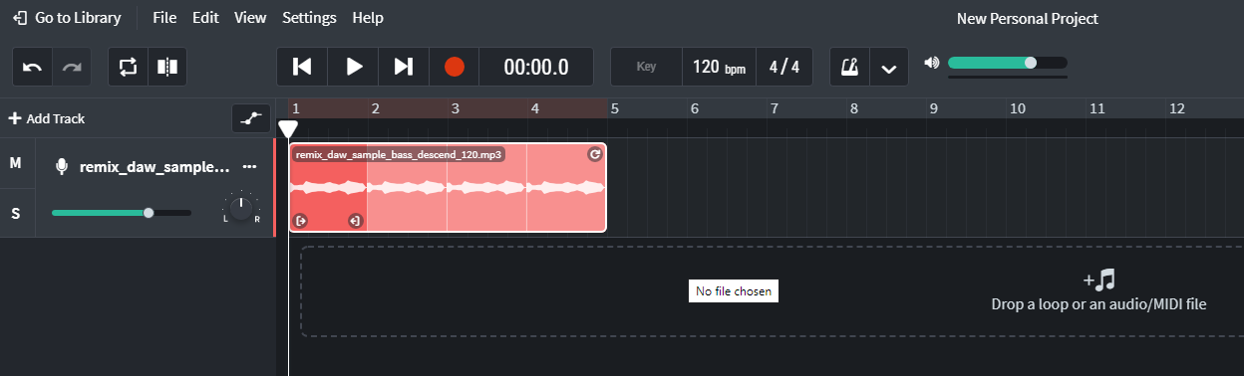
Skill 3: Can you find and use….
MUTE
SOLO
Add a track
Cycle
Go to the beginning?
Play
BPM – how do you change it?
Metronome settings
Loop Packs – Can you find the drum loops

Slide 7
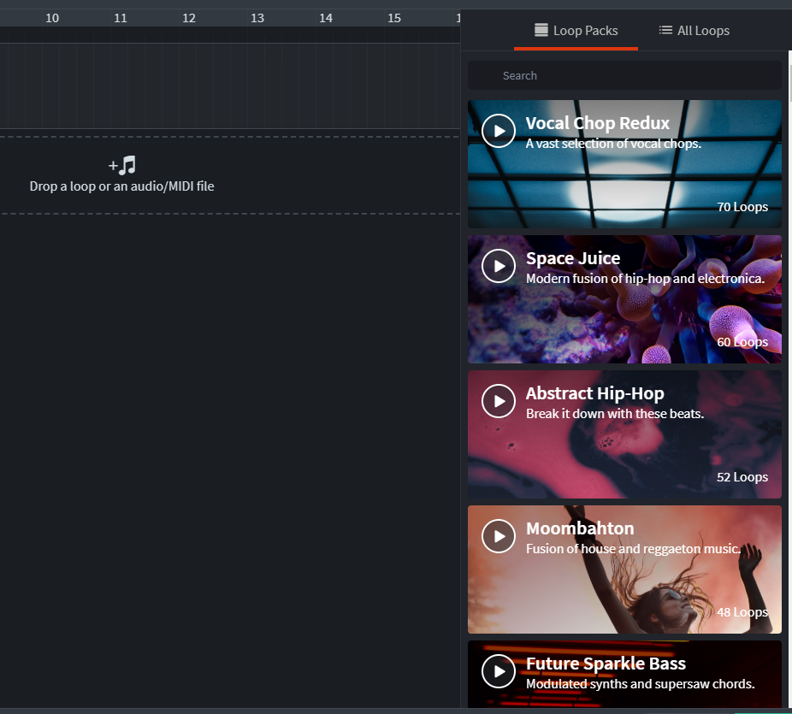
Skill 4 – Adding a pre-made LOOP
Explore the different loops that are on offer and DRAG them into the Loop/Midi track

Slide 8
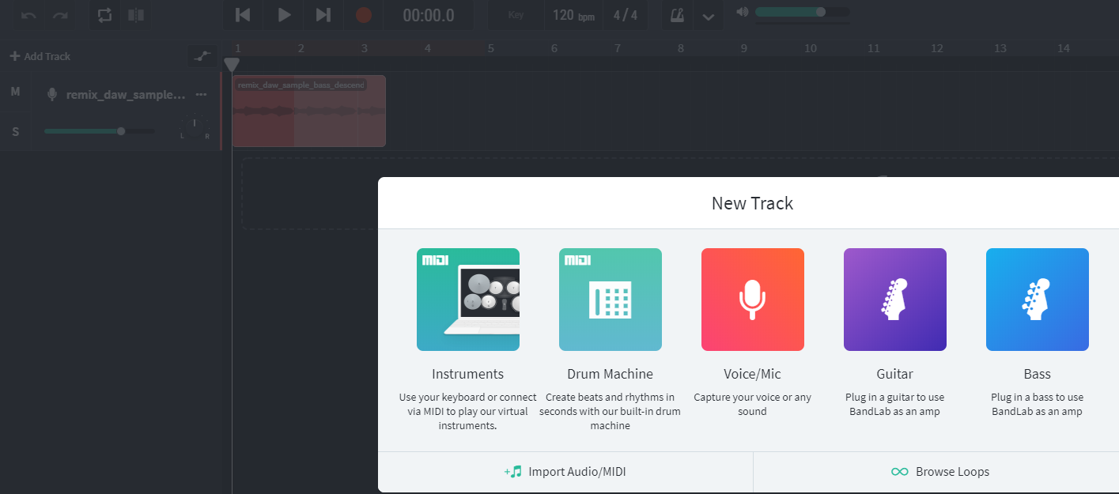
Skill 5 – Add a drum machine
Click ‘Add track’ and select ‘drum machine

Slide 9
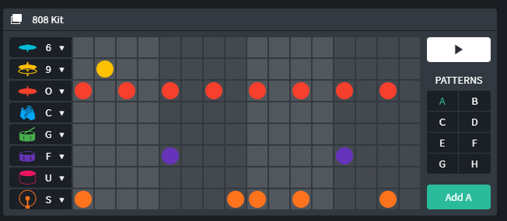
Once you are in the DRUM MACHINE you can choose the different drum sounds and which beat of the bar it plays. It is a 4 beat bar broken into semiquavers. You can also change the type of drum kit. Create your own drum loop by changing where the instruments play.

Slide 10
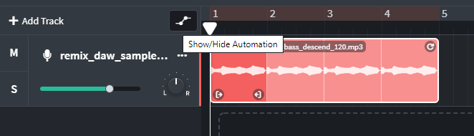
Skill 6: Automation
What is automation?
Automation refers to automating, meaning having a robot or a computer do some task(s) for you. In the case of music production, automation means having a DAW (Band Lab)automatically perform tasks over time, particularly moving knobs, faders, and switches for you.
We are going to look at:

Slide 11
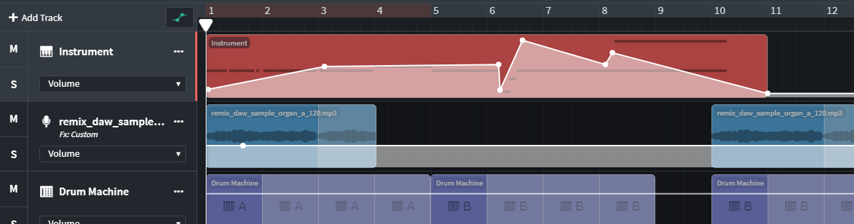
Skill 6: Automation: Volume
Volume – changes how loud or quiet each individual track is and how much fade in or fade out of each track you need.

Slide 12
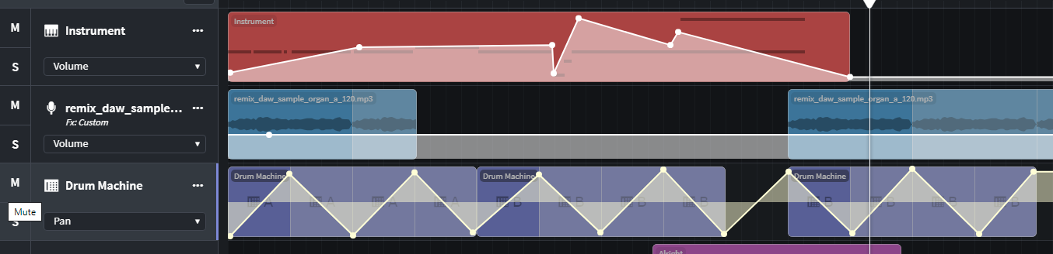
Skill 6: Panning
Panning – changes how much sound of each track comes out of the left and right headphone or speaker.
Miss Jones has Panned HARD RIGHT and HARD LEFT
Q: Does this work for drums? Does this work for any instrument? When might we pan hard left and right?

Slide 13
Panning examples…
Imagine you are the audience.
Which ear gets the most sound?
What percentage of panning should each
instrument have
Which instrument will appear the loudest?

Slide 14
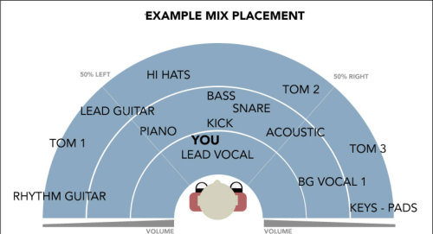

Slide 15
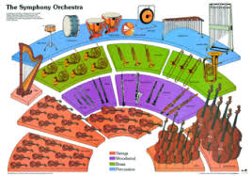

Slide 16
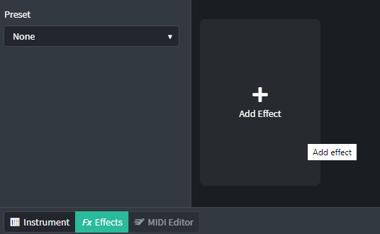
Skill 7 – Adding FX
You can add FX (effects) to each different track.
Explore:
Delay (which makes the track echo like in EDM style)
Reverb (which makes the track sound more live/ acoustic, like singing in a cathedral or in the sports hall!
You can try:
D-Delay

Slide 17
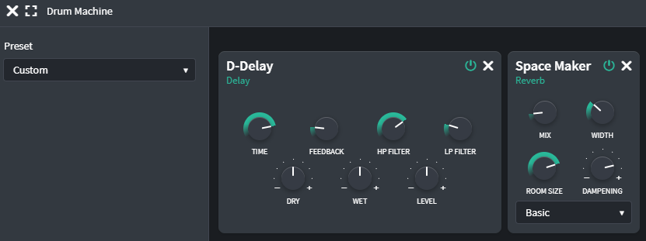
Move the circles very gently – you will find tiny movements can make a big difference to the sound.
Explore:
Time, feedback, filter, Dry and Wet (D-DELAY)
Mix, Width, Room size, dampening (Space Maker)

Slide 18
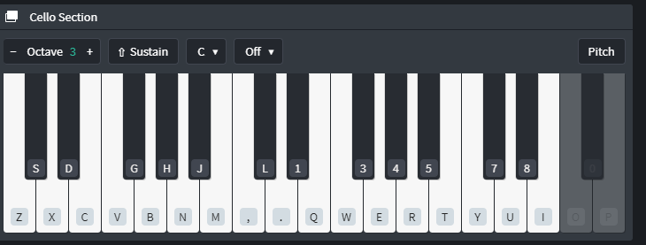
Skill 8 – Adding your own MIDI loops
Create your own 1,2 or 4 beat OSTINATO
You can use the computer keyboard or your MIDI keyboard in front of you
You can have any instrument sound you like
Remember your samples are all in D minor so the following notes will work really well
Foundation: D and A (use a ruler to help find the notes). D is your home note!
Intermediate: DEFGA (D and A are your important start and end of phrase notes)
Higher: DEFGABbC#D (D is your tonic – home note, can you add any chromatic notes?)

Slide 20
Skill 9 – Create your own piece of music
Using all of your new technology skills you are going to create a Bach/ EDM fussion of your own!
Remember your piece needs:
Structure (Introduction, Different sections, Outro, 4 and 8 bar phrases)
Tempo (120 BPM is a good place to start)
Balance (between the tracks and the different sections in the structure)
Interest (Does your music flow? Does it actually sound good!? Do the different sections flow well into one another?)
Music technology (Use skills 1-8 to help include panning,volume, FX, samples, looping, drum loops and your own MIDI samples)!)
Style (Choose your favourite style to fuse)

Slide 21
Success Criteria for your Piece of Music
Foundation…
I can create a piece of music using the audio samples. I am able to drag these into Sound Lab and use a Simple structure that has a start, middle and end. I am able to add a drum loop to accompany my music using the pre-made drum machine. I can explore Automation (Volume) to make the music sound exciting.
Intermediate…
I can also use the audio samples and drum loops. I can use a more interesting structure that uses introduction and ending with different A and B sections with break downs and changes in different FX to make the sections have different feelings. My piece of music has a sense of style because of the remix and compositional decisions I have made. I have explored Automation, and tried to make my own MIDI samples.
Higher…
I can also use the audio samples but have edited them to make them sound more unique. I have added FX and automation appropriately. I can create more complex structures and describe them. I can create my own MIDI ostinatos on MIDI keyboards and create my own effective percussion ideas on the drum pads. My music has a real sense of style and flare and sounds uniquely my own. I have used middle 8 sections, break downs and other musical elements to make my music more interesting.

